Slide 1
Programming Fundamentals Fall 2021
Lecture 5
Dr. Farhan Aadil
farhan.aadil@ciit-attock.edu.pk
DrAadil.com
Please turn OFF your Mobile Phones!

Slide 2
Programming Fundamentals
What are Control Structures?
decision (if) Statements
Switch Statements

Slide 3
What are Control Structures?
Control structures alter the flow of the program, the sequence of statements that are executed in a program.
They act as "direction signals" to control the path a program takes.
Two types of control structures in Java:
decision statements
loops

Slide 4
Program Flow
Java will execute the statements in your code in a specific sequence or flow which can be described through a flow diagram:
a simple program
statement
statement
statement
statement
statement
statement
statement
statement
statement

Slide 5
Decision Statements
A decision statement allows the code to execute a statement or block of statements conditionally.
Two types of decisions statements in Java:
if statements
switch statements

Slide 6
Programming Fundamentals
What are Control Structures?
If Statements
Switch Statements

Slide 7
If Statement Syntax
if (expression/condition) {
// block of code to be executed if the condition is true
}
else {
// block of code to be executed if the condition is false
}
rest_of_program
expression must evaluate to a boolean value, either true or false
If expression is true, statement is executed and then rest_of_program
If expression is false, statement is not executed and the program continues at rest_of_program

Slide 8
If-Else Flow Diagram
The if-else decision statement executes a statement if an expression is true and a different statement if it is not true.
is
“expression”
true?
yes
no
if (expression){
statement1;
} else {
statement2;
}
rest_of_program..
execute
statement1
execute
statement2
execute
rest_of_program

Slide 9
License Program
public class Input {
public static void main(String[] args) {
Scanner scan = new Scanner (System.in);
System.out.print ("Enter your age: ");
int age = scan.nextInt();
System.out.println ("You entered: " + age);
if (age < 18)
System.out.println ("You are not eligible for license");
else
System.out.println ("You are eligible");
}
}

Slide 10
Chained If-Else Statements
if (grade == 'A')
System.out.println("You got an A.");
else if (grade == 'B')
System.out.println("You got a B.");
else if (grade == 'C')
System.out.println("You got a C.");
else
System.out.println("You got an F.");

Slide 11
Chained If-Else Statements
if (grade == 'A')
System.out.println("You got an A.");
if (grade == 'B')
System.out.println("You got a B.");
if (grade == 'C')
System.out.println("You got a C.");
else
System.out.println("You got an F.");

Slide 12
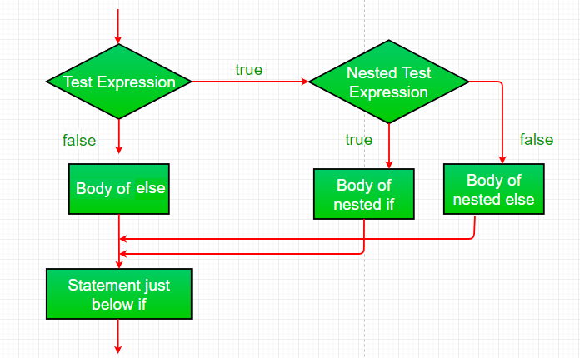
Nested If statements

Slide 13
MinOfThree.java
…
int num1, num2, num3, min = 0;
Scanner scan = new Scanner (System.in);
System.out.println ("Enter three integers: ");
num1 = scan.nextInt();
num2 = scan.nextInt();
num3 = scan.nextInt();
if(expression)
………………………………
System.out.println ("Minimum value: " + min);
}
}

Slide 14
Programming Fundamentals
What are Control Structures?
If Statements
Switch Statements

Slide 15
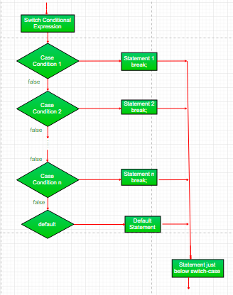
Switch Statements
Flow of Switch Statement

Slide 16
Switch Statement Syntax
The switch statement enables you to test several cases generated by a given expression.
For example: switch (expression) { case value1: statement1;
Break;
case value2: statement2;
Break;
default: default_statement;
}

Slide 17
Switch Example
public class SwitchExample {
public static void main(String[] args) {
int number=20;
switch(number)
{
case 10:
System.out.println("10");
break;
case 20:
System.out.println("20");
break;
case 30:
System.out.println("30");
break;
default:
System.out.println("Not in 10, 20 or 30");
}
}
}

Slide 18
Switch Example
This is how it is accomplished with a switch:
if-else chains can be sometimes be rewritten as a “switch” statement.
switches are usually simpler and faster
switch (grade) { case 'A': System.out.println("You got an A."); break; case 'B': System.out.println("You got a B."); break; case 'C': System.out.println("You got a C."); break; default: System.out.println("You got an F."); }

Slide 19
Switch Example
class SwitchDate{
public static void main(String[] args){
int week = 3;
switch (week){
case 1: System.out.println("monday");
break;
case 2: System.out.println("tuesday");
break;
case 3: System.out.println("wednesday");
break;
case 4: System.out.println("thursday");
break;
case 5: System.out.println("friday");
break;
case 6:
System.out.println("saturday");
break;
case 7:
System.out.println("sunday");
break;
default: System.out.println("Invalid week");
break;
}
}
}

Slide 20
Switch
switch (num) {
case 1:
case 2:
case 3:
case 4:
case 5:
System.out.println("1 through 5");
break;
case 6:
case 7:
case 8:
case 9:
case 10:
System.out.println("6 through 10");
break;
}

Slide 21
Switch
char c= 'a';
switch(c)
{
case 'a’:
case 'A’:
System.out.print("Hello world");
break;
}

Slide 22
Grade Report
public class GradeReport
{
public static void main (String[] args)
{
int grade, category;
Scanner scan = new Scanner (System.in);
System.out.print ("Enter a numeric grade (0 to 100): ");
grade = scan.nextInt();
category = grade / 10;
System.out.print ("That grade is ");

Slide 23
Grade Report
switch (category)
{
case 10:
System.out.println ("a perfect score. Well done.");
break;
case 9:
System.out.println ("well above average. Great.");
break;
case 8:
System.out.println ("above average. Nice job.");
break;
case 7:
System.out.println ("average.");
break;
case 6:
System.out.println ("below average.");
System.out.println ("See the instructor.");
break;
default:
System.out.println ("not passing.");
}
}
}

Slide 24
Important links
My email: farhan.aadil@ciit-attock.edu.pk
My web page: DrAadil.com
Thanks for listening! Ready for Questions & Answers ☺

